Slide 1

The Carpentries
“We teach foundational coding and data science skills to researchers worldwide”

Slide 2


Open source for open science
Resources
Lessons are developed collaboratively on GitHub
Licence
Lessons are freely available under CC-BY
Contributions
All kinds of contributions are welcome

Slide 3
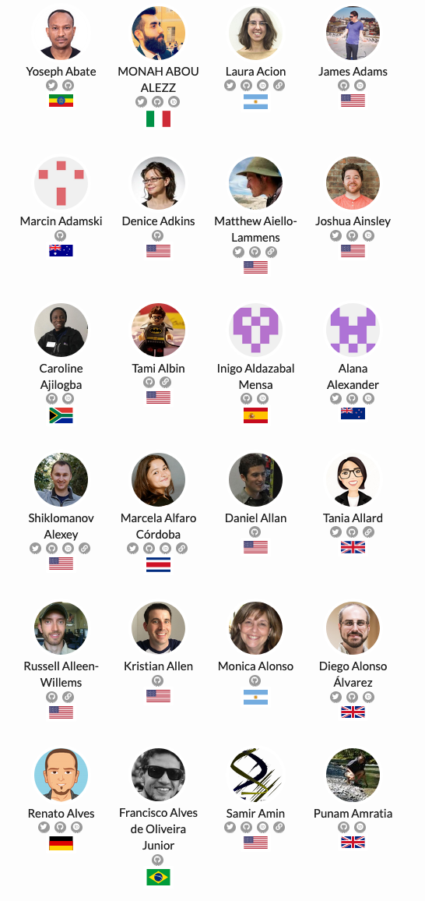
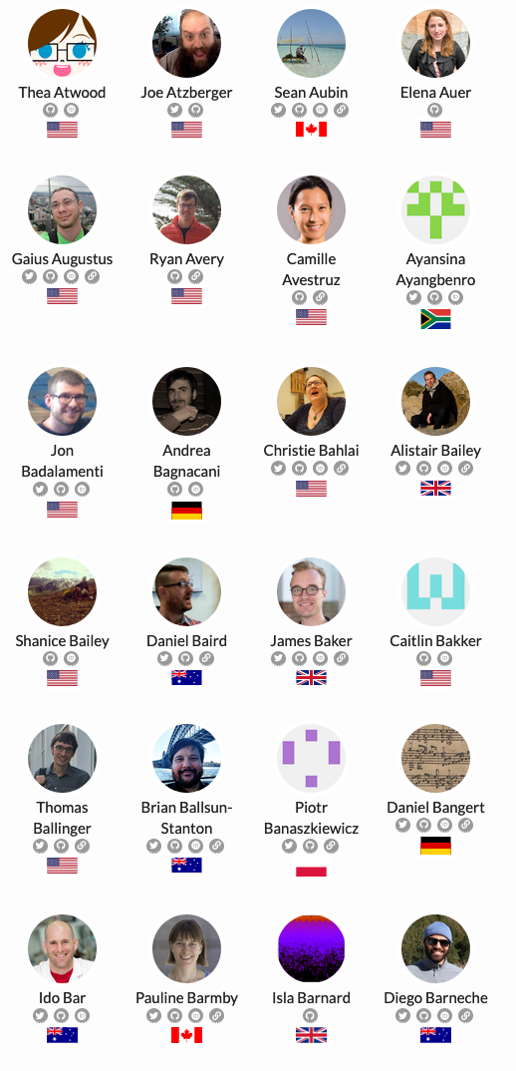
Ethos
Volunteering
Inclusivity and respect
Code of Conduct

Slide 4
Learners, instructors, and trainers
https://carpentries.org/blog/2021/04/trainer-training/

Slide 5

Workshop format
A workshop is a group of self-contained ‘lessons’, ranging from 3 hours to 2 full days
Teach and do exercises with live coding and code-along
Instructor plus co-instructor and one or more helpers
Live feedback and pre/post workshop surveys

Slide 6
Lesson development life cycle
https://carpentries.github.io/curriculum-development/the-lesson-life-cycle.html

Slide 7



Lesson programs

